Slide 1

WIPRO NGA Program – LSP Batch
Capstone Project Presentation – 26 August 2024
Project Title – Online Food Order
Presented by – CPPE4
www.rpsconsulting.in

Slide 2

Project Information
Project Name: Foodiee
Project Description: Foodiee App is an online food ordering application that allows users to order food. The app will have features such as user registration, login, food selection, payment, and order management.
2024 - RPS Consulting
all rights reserved

Slide 3
Technical Details:
Architecture:
Frontend: React (using Visual Studio)
Backend: Spring Boot, Spring JPA (using STS)
Database: MySQL 8
Tools Used:
Visual Studio (for frontend development)
STS (for backend development)
MySQL 8 (for database management)
Postman (for API testing)
2024 - RPS Consulting
all rights reserved

Slide 4
Project Details:
Login and Registration
The first screen will be the login screen with a registration link.
If the user enters valid credentials, they will be redirected to the next screen (Story 2).
If the credentials are incorrect, an error message will be displayed, and the user will remain on the login screen.
If the user clicks on the registration link, a registration form will be displayed with a signup button.
The user can register, and if the account already exists, an error message will be displayed.
After signing up the user will be navigated back to sign in page
From the registration form, if the user clicks on the login button, the login form will be displayed.
2024 - RPS Consulting
all rights reserved

Slide 5
Display the Food
After a valid user logs in, they will be able to choose the type of food (Veg-food, Non-veg food, and Chinese Food).
After selecting the type of food, the food items of user choice will be displayed.
User Selection and Payment
The user will be able to select items from the list and click on "Proceed to Billing".
The payment screen will be displayed, and the user can choose from Credit Card, Debit Card, UPI, and Cash on Delivery.
After selecting the payment method and entering the required details, the user will click on the "Order" button.
The food will be ordered, and a success message will be displayed.
The order will be inserted as a new record in the database.
2024 - RPS Consulting all rights reserved

Slide 6
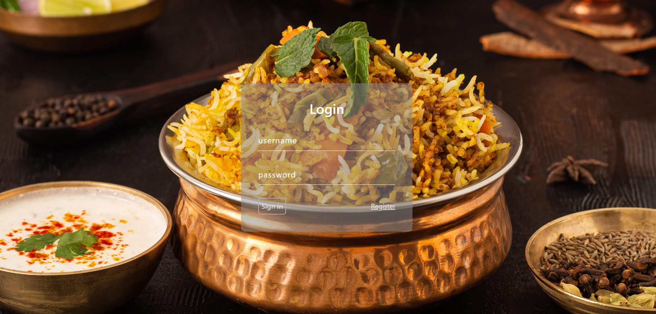

Slide 7
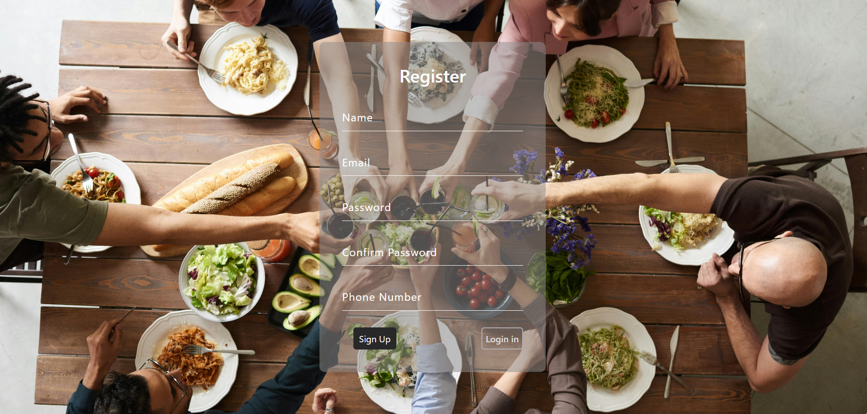

Slide 8
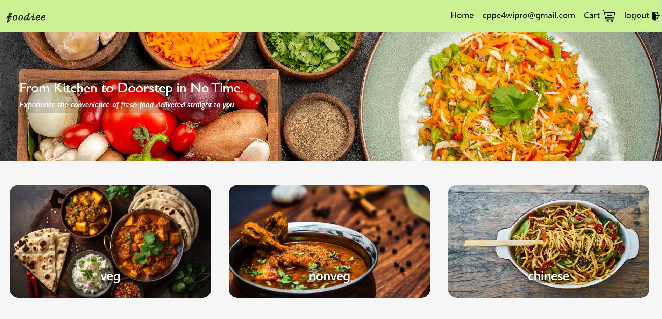

Slide 9
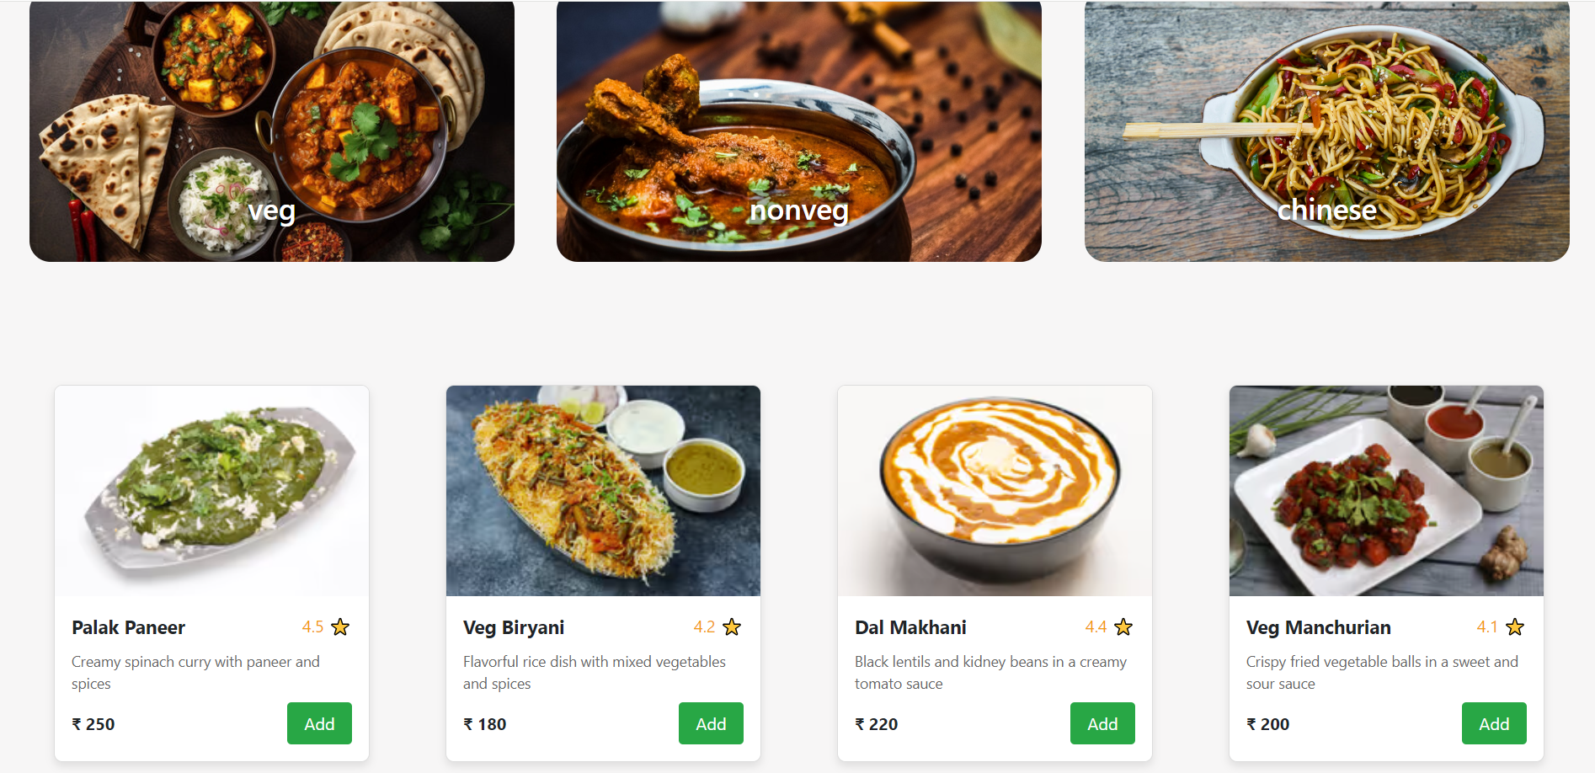

Slide 10
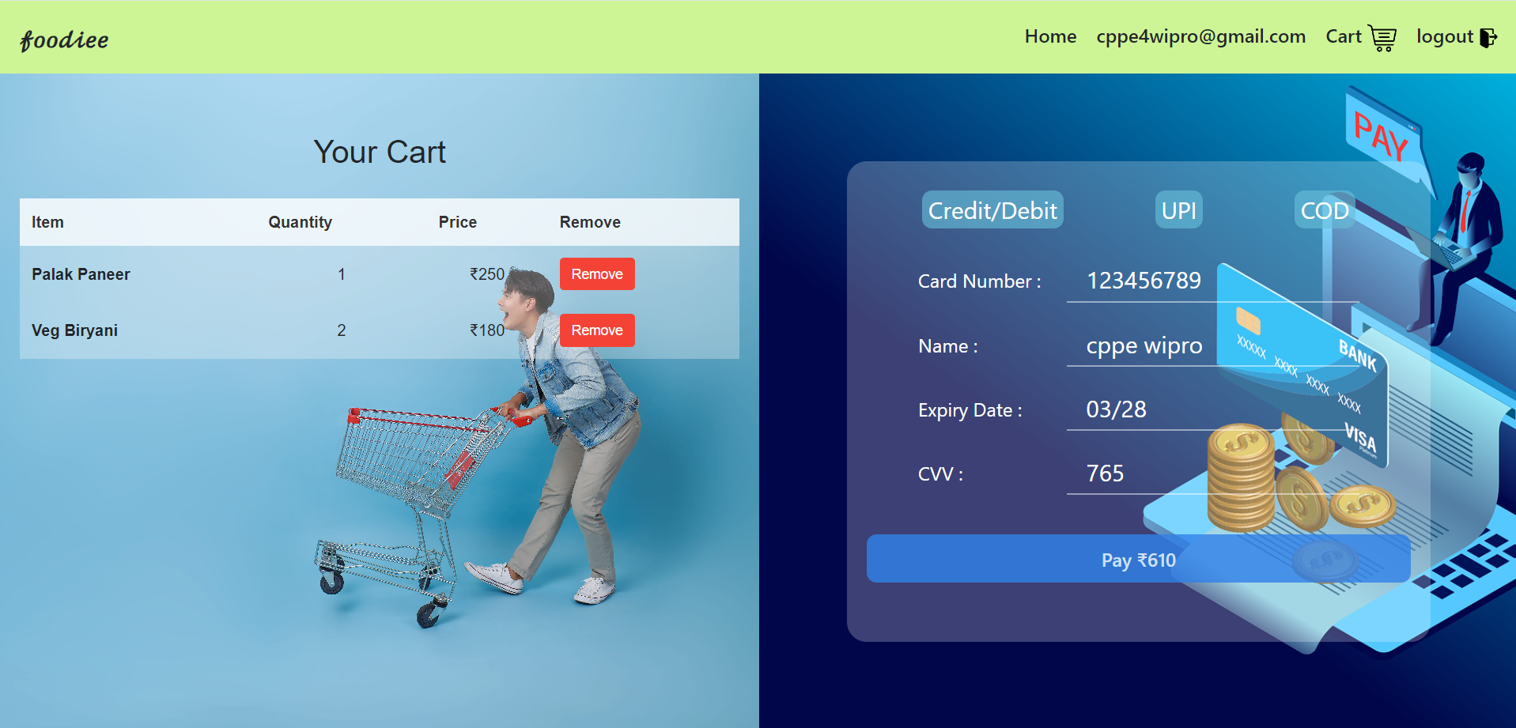

Slide 11
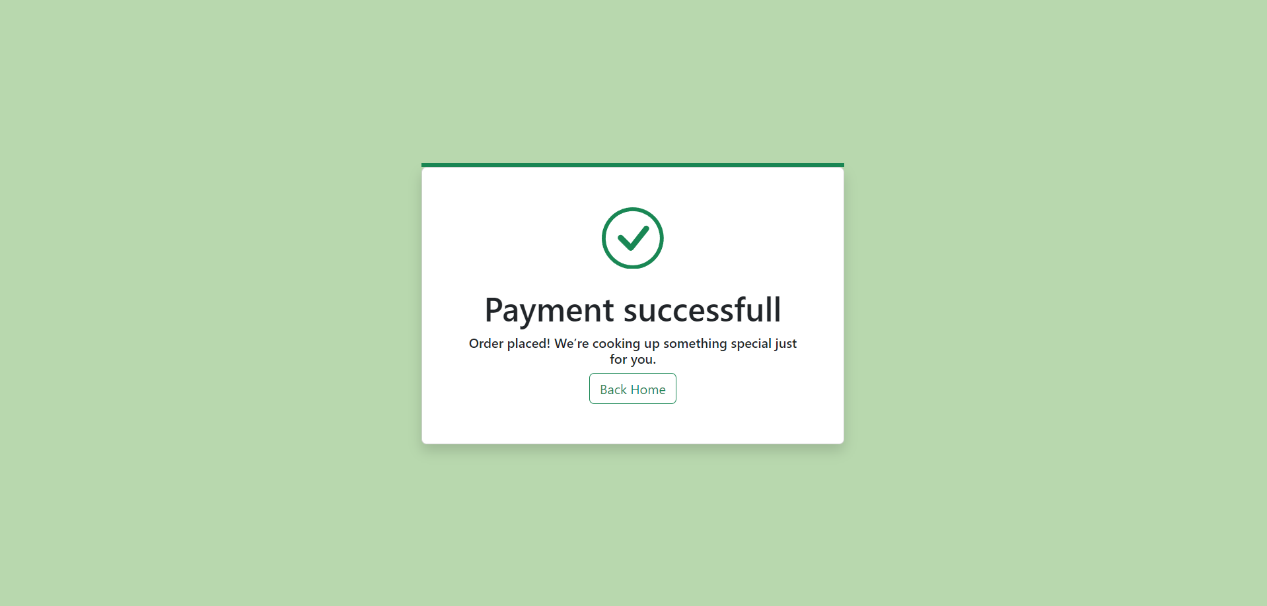

Slide 12
Team:
Potti Yashwanth Reddy
purna chandrasekhar Boggavarapu
modugula sai geethika
Kondepudi Bhaskara Sai Subrahmanyam
Muthyalu Pilli
References:
React Reference: https://react.dev/learn
Spring Boot Reference: https://spring.io/projects/spring-boot
Spring JPA Reference: https://spring.io/projects/spring-data-jpa
MySQL/DB Reference: https://dev.mysql.com/doc/
2024 - RPS Consulting
all rights reserved

Slide 13

2024 - RPS Consulting all rights reserved

